Slide 1
Syntax Analysis - Parsing

Slide 2
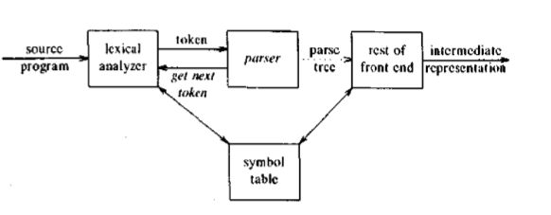
Position of the parser in Compiler:

Slide 3
Two types of Parsers are present in compilers:
1. Top down Parsers.
They build parse trees from the root node to the leaf nodes.
2. Bottom up Parsers.
They build parse trees from the leaf nodes and work up to the root node. In both the cases, the input to the parser is read from left to right , one symbol at a time.

Slide 4
Syntax Error handling
Programs can have errors at different levels. These are as follows:
1. Lexical such as a miss-spelt identifier, keyword or operator.
2. Syntactic such as unbalanced parenthesis.
3. Semantic such as an operator applied to an incompatible operand.
4. Logical such as an infinite recursive call.

Slide 5
Goals of the error handler:
1. It should report the presence of errors accurately and clearly.
2. It should recover from each error quickly enough to detect subsequent errors.
3. It should not subsequently slow down the processing of the system.
Viable prefix property- It detects that an error has occurred as soon as it sees a prefix of the input that is not a prefix of any string in the language.

Slide 6
Error-Recovery Strategies
The following strategies are employed by the compiler to recover from a syntax error:
1. Panic mode- Simple mode of error recovery. On discovering an error, the parser discards input symbols one at a time until one of a designated set of synchronizing tokens is found. While panic-mode correction often skips a considerable amount of input without checking it for additional errors, it has the advantage of simplicity and unlike some other methods to be considered later, it is guaranteed not to get into an infinite loop. In situations where multiple errors in the same statement are rare, this method may be quite adequate.
2. Phrase level recovery- On discovering an error, a parser may perform local correction on the remaining input; that is, it may replace a prefix of the remaining input by some string that allows the parser to continue.

Slide 7
A typical local correction would be to replace a comma by a semicolon, delete an extraneous semicolon or insert a missing semicolon. Its major drawback is the difficulty it has in coping with situations in which the actual error has occurred before the pint of detection.
Error productions- If an error production is used by the parser, we can generate appropriate error diagnostics to indicate the erroneous construct that has been recognized in the input.

Slide 8
Global correction-There are algorithms for choosing a minimal sequence of changes to obtain a globally least cost correction. Given an incorrect input string ‘x’ and grammar ‘G’. These algo- rithms will find a parse tree for a related string ‘y’, such that the number of insertions, deletions and changes of tokens required to transform ‘x’ into ‘y’ is as small as possible. But these algorithms are too costly to implement in terms of time and space.

Slide 9
Parsing
Parser :
Input : Sequence of tokens from lexer
Output : Parse Tree of the program
Phase Input output
Lexer String of characters String of Tokens
Parser String of Tokens Parse Tree
Parsing with Context Free Grammar (CFG)
Not all strings of tokens are programs
Parser must distinguish between valid and invalid Strings of Tokens
We need:-
A language for describing valid strings of tokens.
A method for distinguishing valid from invalid string of tokens.
Programming languages have recursive structure.

Slide 10
Parsing
An expr is
if(expr){
expr....
}
else { expr.....}
while(expr){ expr.....}
.........
.........
A CFG consists of:
- A set of terminals T
- A set of non-terminals V
- A Start symbol S
- A set of productions P
X -> Y1........Yn
X belongs to N and Yi belongs to V U T U {epsilon}

Slide 11
Parsing
Example:
S -> ( S )
S -> epsilon
Here, N = {S} T = {(, )}
stmt -> if(expr) stmt else stmt
N = {stmt, expr} T = {if, else}
S = {stmt} and P = {stmt-> if(expr) stmt else stmt}
Step 1: Begin with a string with only the start symbol S.
Step 2: Replace any non-terminal X in the string by the right hand side of the production X->y1......yn
Step 3: Repeat step 2 until there are no non-terminals.
X1........Xi X Xi+1...........Xn -> X1........Xi Y1........Yk Xi+1...........Xn
X->Y1......Yk

Slide 12
Parsing
Let G be a CFG with start symbol S, then the language L(G) of G is:
*
L(G) = {a1.......an | ai belongs to T for all i and S----->a1...........an}
Terminals ought to be tokens of the language.
Simple arithmetic Expression
E -> E+E | E*E | E-E | (E) | id
id
id+id
id+id*id are the languages of the given CFG.
id-id
(id+id)*id
Membership in a language is "Yes" or "No".
Also need parse tree of the input.

Slide 13
Parsing
*
S---->p
Sentence vs Sentential Form of CFG G.
(id+id)
E -> (E)
-> (E+E) Sentential Form of G
-> (id+E)
-> (id+id) Sentence of G

Slide 14
Parsing
Derivation
A derivation is a sequence of productions
S->....->....->....->....
A derivation can be drawn as a tree
- Start symbol is the tree's root.
- For a production X -> Y1......Yn, add children Y1......Yn to node X.
X
Y1........................Yn
Consider the following Grammar:
E -> E+E | E*E | E-E | (E) | id
String : id*id+id
E
-> E+E
-> E*E+E Derivation Starting from E
-> id*E+E
-> id*id+E
-> id*id+id

Slide 15
Parsing
E -> E+E | E*E | E-E | (E) | id
String : id*id+id
E
-> E+E
-> E*E+E Derivation Starting from E
-> id*E+E
-> id*id+E
-> id*id+id
E
E + E
E * E id
id id
Parse Tree for id*id+id

Slide 16
Parsing
A Parse Tree has:
- terminals at the leaves
- non-terminals at the interior nodes
Two types of derivation
Left Most Derivation
Right Most Derivation
Left Most Derivation - At each step replace the left most non-terminals.
Right Most Derivation - At each step replace the left most non-terminals.
E
-> E+E
-> E+id Derivation Starting from E
-> E*E+id
-> E*id+id
-> id*id+id
The left most and the right most derivations have the same parse tree.

Slide 17
Parsing
The left most and the right most derivations have the same parse tree.
E
E + E
Adding branches to this side -LMD Adding branches to this side -RMD
Conclusion:
Need Parse Tree for string S.
Derivation
Parser Implementation

Slide 18
Parsing
Ambiguity
Consider the following Grammar:
E -> E+E | E*E | E-E | (E) | id
and String : id*id+id
E E
E + E E * E
E * E id id E + E
id id id id
Parse Tree for id*id+id Parse Tree for id*id+id
E -> E + E E -> E*E
-> E*E + E -> E* E+E
* *
-> id*id+id -> id*id+id

Slide 19
Parsing
A Grammar is ambiguous if it has more than one parse tree for same string.
Ambiguity must be removed.
How to handle ambiguity?
Design an equivalent unambiguous grammar.
E -> E1 + E | E1
E1 -> id*E1 | id | (E)*E1 | (E)
E
E1 + E
id * E1 E1
id id
Parse Tree for id*id+id

Slide 20
Parsing
Q. Consider the Grammar:
stmt -> if expr then stmt
| if expr then stmt else stmt
| other
The expression ‘if E1 then if E2 then S1 else S2’ has two parse trees.

Slide 21
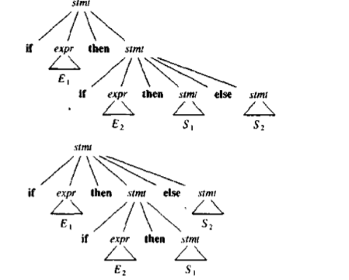

Slide 22
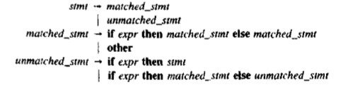
Parsing
In most programming languages, the first parse tree is preferred. The general rule is: "Match each ‘else’ statement with the closest previous unmatched ‘then’ statement.”

Slide 23
Parsing
Precedence and Associativity declarations - To disambiguate grammars
Consider the Grammar:
E -> E + E | int
and String : int+int+int
E E
E + E E + E
E + E int int E + E
int int int int
Left associativity declaration : left +

Slide 24
Parsing
Consider the Grammar:
E -> E+E | E*E | int
and String : int+int*int
E E
E * E E + E
E + E int int E * E
int int int int
prec(*) > prec(+)

Slide 25
Parsing
L -> (E) | digit
P -> -P | L
F -> P power F | P
T -> T*F | T/F | F
E -> E+E | E-E | E*E | E/E | -E | (E) | E power E | digit
can be written as:
E -> E+T | E-T | T
T -> T*F | T/F | F
F -> (E) | digit

Slide 26
Parsing
Q. Draw the parse tree for
9-5-2
9-5+2

Slide 27
Parsing
Transition Diagram(TD)
- Directed graph
- node ( state)
- edge (transition)
- shows picture of RE
Draw the TD for the following:-
Identifier and keywords
2. Relational Operators
3. Unsigned numbers

Slide 28
Parsing
letter/digit
start letter other
gettoken(), install_id()
ab, abc
one valid identifier other
identifier ab
gettoken() install_id()
2
3
1

Slide 29
Parsing
Relational operator

Slide 30
Parsing
Parsing Methods:
-Top-Down
-Bottom-Up
Top-Down Parsing
The parse tree is constructed:
-from the top (starting from root)
- from left to right
-Terminals are seen in order of appearance in the token stream.
Consider the grammar:
S->cAd
A->ab|a
and the string x = cad

Slide 31
Parsing
Consider the grammar:
S->cAd
A->ab|a
and the string x = cad
S S
c A d c A d
a b a
X
backtracking

Slide 32
Parsing
Consider the Grammar
E -> T | T+E
T -> int | int*T | (E)
and Token stream is : (int)
Start with top-level non-terminal E
E -> T | T+E
T -> int | int*T | (E)
Ist time 2nd time 3rd time
1st Time: E
T
int ===> mismatch: int does not match therefore backtrack.
undo that

Slide 33
Parsing
2nd Time: E
T
int * T ===> mismatch: int does not match therefore backtrack again.
undo that
3rd Time: E
T
( E ) ===> match: Advance input.
T ===> 1st production E->T
int ===> 1st production T->int
===> match..Advance input. Since no input therefore Accept.

Slide 34
Parsing
Recursive Descent Algorithm
bool term(TOKEN tok){ return *next++ == tok; }
bool E1(){ return T(); }
bool E2(){ return T() && term(PLUS) && E(); }
bool E(){ TOKEN *save = next; return (next = save, E1())
|| (next = save, E2());
}
bool T1(){ return term(INT); }
bool T2(){ return term(INT) && term(TIMES) && T(); }
bool T3(){ return term(OPEN) && E() && term(CLOSE); }
bool T(){ TOKEN *save = next; return (next = save, T1())
|| (next = save, T2())
|| (next = save, T3());
}

Slide 35
Parsing
Algorithm: Recursive Descent Parsing
Input : Grammar G and Styarting Symbol S
Output : String Accepted or Error Message
Method:
S(){
if input[i] == 'c' then
{
i++;
if A() then
if input[i] ='d' then
{
i++;
return true;
}
return false;
}
}

Slide 36
Parsing
A(){
isave = i;
if input[i] == 'a' then
{
i++;
if input[i] == 'b' then
{
i++;
return true;
}
i = isave; // backtracking
}
if input[i] == 'a' then
{
i++;
return true;
}
return false;
}

Slide 37
Parsing
main(){
read string;
if S()
print "String Accepted"
else
print "Error Message"
}

